Slide 1
Skyview PTSA Meeting
October 4, 2023

Slide 2
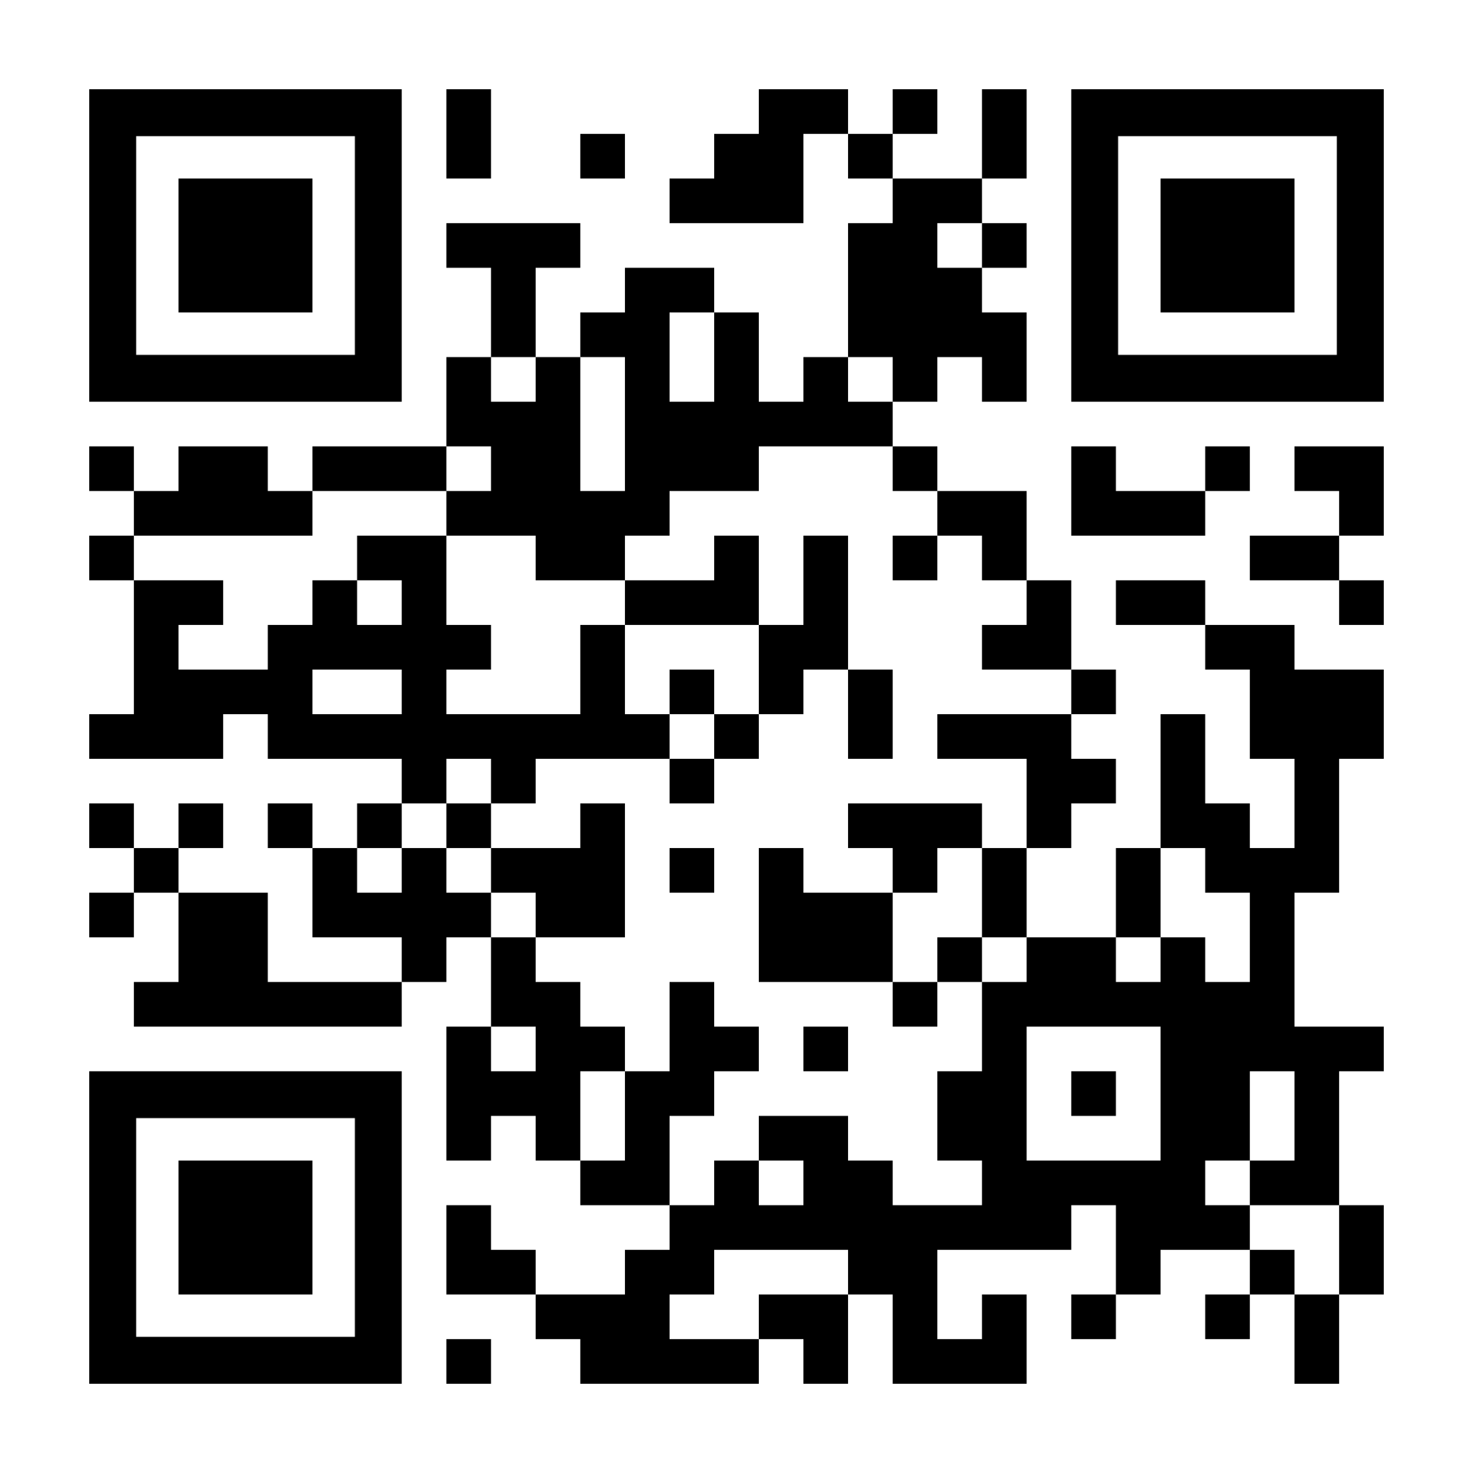
What is happening at Skyview:
The Grade level Road Shows: Creating a safe school culture
The daily School Scoop: Building community
Signage around the school
Communication to the school community
Tell Us More - share your insights

